Slide 1
Spatial Data Mining

Slide 2
Data mining
Spatial auto-correlation
Spatial colocation pattern
Spatial outliers

Slide 3
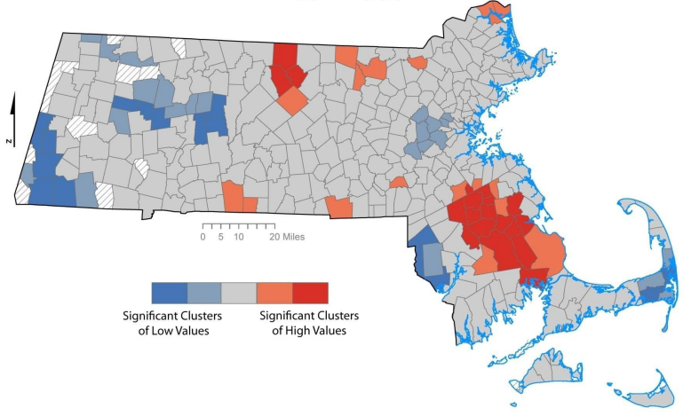
Spatial Statistics
Hot Spot Analysis
Notes:
cardio-vascular disease hotspot
Density can tell you where clusters in your data exist, but not if your clusters are statistically significant.
Hotspot analysis uses vectors (not rasters) to identify the locations of statistically significant hot spots and cold spots in data
High z score and low p value = hot spot.
GI(d) evaluates the call data by comparing the local mean to the global mean and then determining whether the difference between them is statistically significant. To the layperson, this mean, the tool determines where more calls than expected occur and where fewer calls than expected occur. Hot spot analysis determines how likely it is that there is a pattern like this one if the underlying processes are random.
This particular map illustrates an analysis of 911 call data. To perform this analysis, we created a model that integrates several spatial statistic tools. Our mission was to evaluate the spatial pattern of these 911 calls and look for hot spots. That is, we wanted to see where the calls were clustering together in space. Then, ultimately using the results of our hot spot analysis, we wanted to compare clustering that we found to the location of emergency response stations. In the upper left, each of the points represents a single call into a 911 dispatch center. Notice that it would be difficult to find whether and where clustering exists. Certainly, some areas appear to be clustered, but even with a truly random pattern, we expect to see some pockets of local clustering. The first thing our model did was collect the incident data into weighted points. This yielded single features for locations with counts of calls (upper right map). The weighted points show some clustering more clearly, such as near the center. The question remains as to whether this cluster is statistically significant or not. To answer that question we used Getis-Ord G* statistics. The idea was to learn where we were getting more calls than expecedt and where we were getting fewer calls than expected. The Hot Spot Analysis tool evaluates the call data by comparing the local mean to the global mean and then determining whether the difference between them is statistically significant—in other words, how likely it is that we would see a pattern like this one if the underlying processes are random. The results are presented as standard deviation z-scores (lower left). Once these were calculated, we could immediately see the 911 call clustering. The red indicates a lot of calls. The blue shows that, given the overall region, areas that don’t get very many calls. To get a clearer idea, these points were interpolated into a surface (lower right). Results: Locations of emergency response stations. Two stations are located in hot spots. The third may not be ideally located.

Slide 4
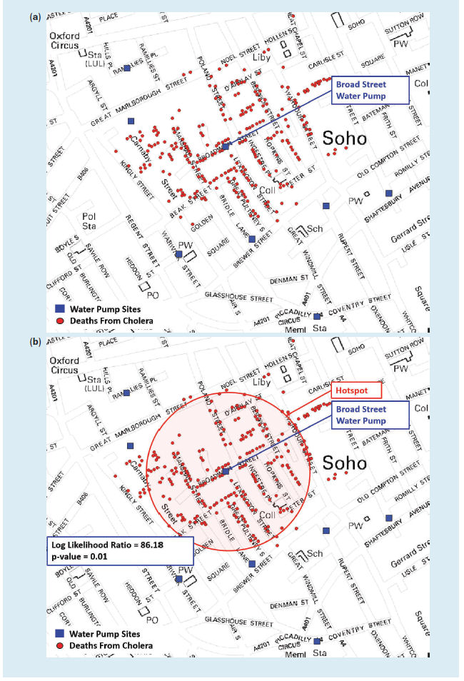
Spatial Statistics
Notes:
1850
Water pump cholera locations
Several days
Public health agencies use statistics to detect outbreak
Spatial statistics are one order of magnitude more computational and data intensive than traditional statistics.

Slide 5
Hot Spot Analysis (Getis Ord)
Density can tell you where clusters in your data exist,
but not if your clusters are statistically significant
Hotspot analysis uses vectors (not rasters) to identify the locations of statistically significant hot spots
How Hot Spot Analysis Really Works (18 minutes)
https://www.youtube.com/watch?v=47Lxo10-ef8
Hot Spot analysis using Moran's I and getis-ord statistics in ArcMap/ArcGIS
https://www.youtube.com/watch?v=_0Tzo1qbN-A&list=PLvLHpy6f_PaNKus-bMnRWXBjPv-VXTQQ-&index=28

Slide 7
Colocation Pattern mining
Discovering the group of objects or events that co-occur at many places
Diseases (e.g., lung cancer) may co-occur with certain environmental factors (e.g., air pollution)
Nile Crocodiles → Egyptian Plover
- predicts the presence of Egyptian Plover birds in areas with Nile Crocodiles
Stagnant water source → West Nile disease,
- predicts the presence of West Nile disease in areas with stagnant water sources

